Slide 1

Present perfect
1

Slide 2



WELCOME everybody

Slide 3


LEARNING
Verb to have
had having had has have
Education
Present perfect

Slide 4
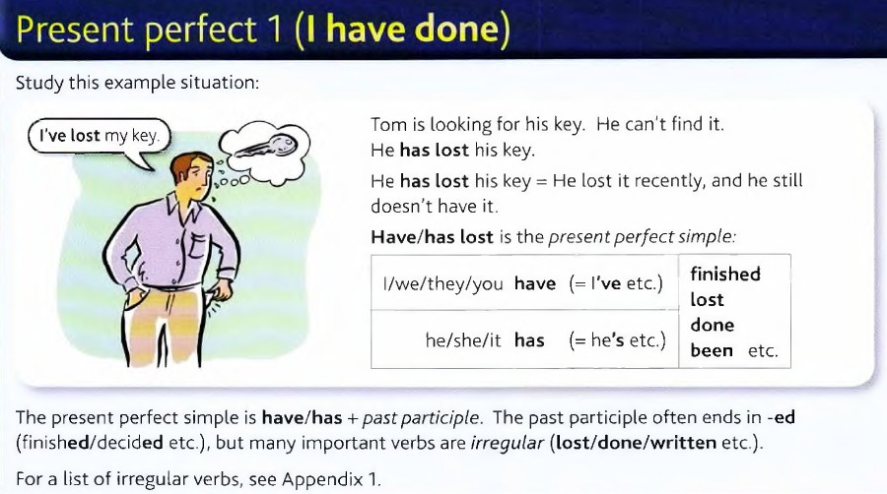

Slide 5
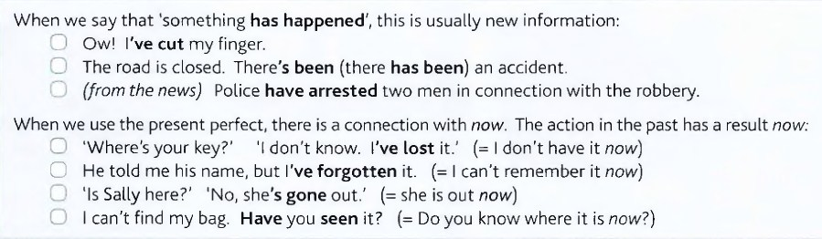


Slide 6
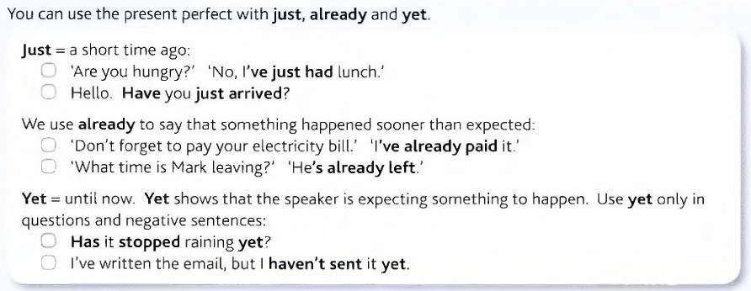
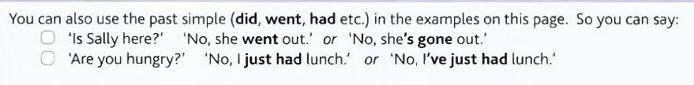

Slide 7




form
Subject + have, has+ (p.p verb) + co.
Negative
Subject + have, has + not + (p.p verb) + co.
Interrogative
Have, has + subject + (p.p verb) + co.

Slide 8

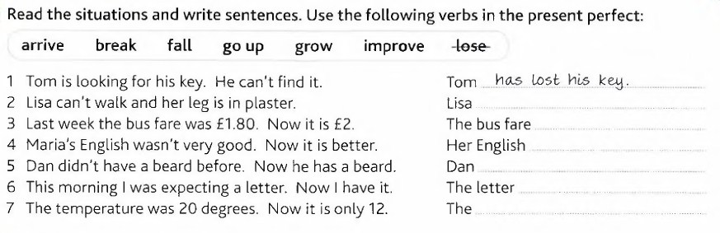
The exercises
has broken her leg.
has gone up.
has improved.
has grown beard.
has arrived.
temperature has fallen.

Slide 9
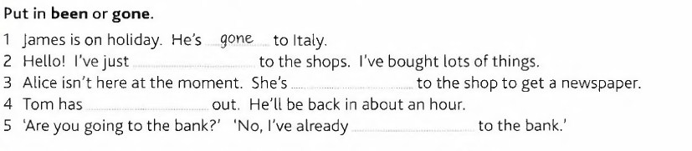
The exercises
been
gone
gone
been

Slide 10
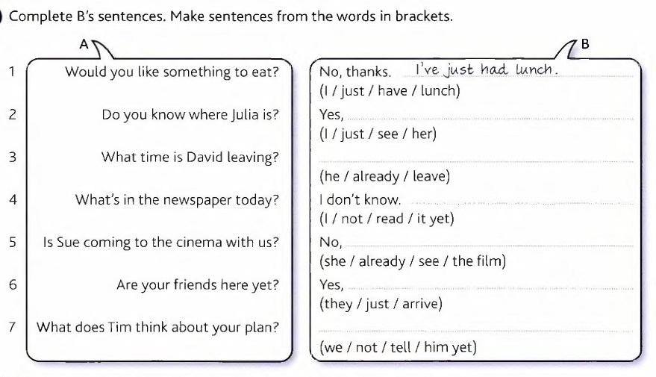
The exercises
I have just seen her.
He has already left.
I haven’t read it yet.
she has already seen the film.
they have just arrived.
We haven’t told him yet.

Slide 11
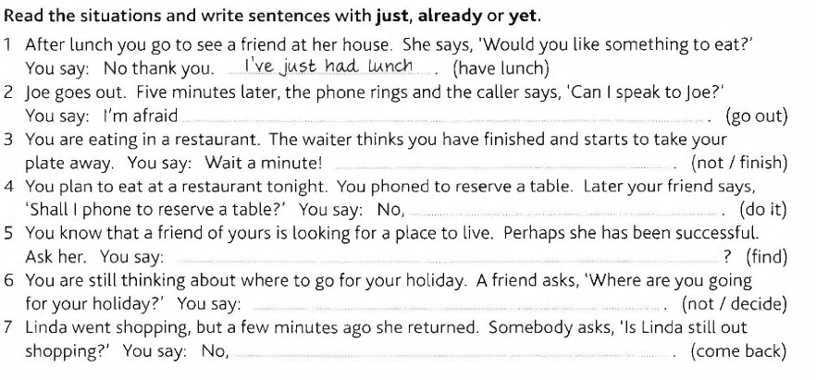
The exercises
he has just gone.
I haven’t finished yet.
I have already done it.
Have you found a place to live.
I haven’t decided yet.
She has just come back.

Slide 12



Some of useful idioms
Any more & anymore are used
Question 2. Negative
Note: any more is not usually used in affirmative (positive)
Any more vs. anymore
Any more + noun (pl.) = determiner
Do you need any more information about my family?
I do not want any more coffee, I have already had
two cups
Determiner: is a word before a noun phrase, but it is no adj.
Determiner means article, numbers, possessive, quantifier ….etc.
Adverb : is a word that gives us more a information about a verb. The position of anymore as an adverb is at the end of sentence.
Anymore =(adv.) means no longer
Suha looks tired, she is not running anymore.
I do not play the guitar anymore.

Slide 13
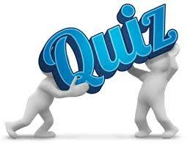
Some of useful idioms
Any more vs. anymore
I don’t want any more water because I am not thirsty anymore.

Slide 14
GOOD bye!

Slide 15
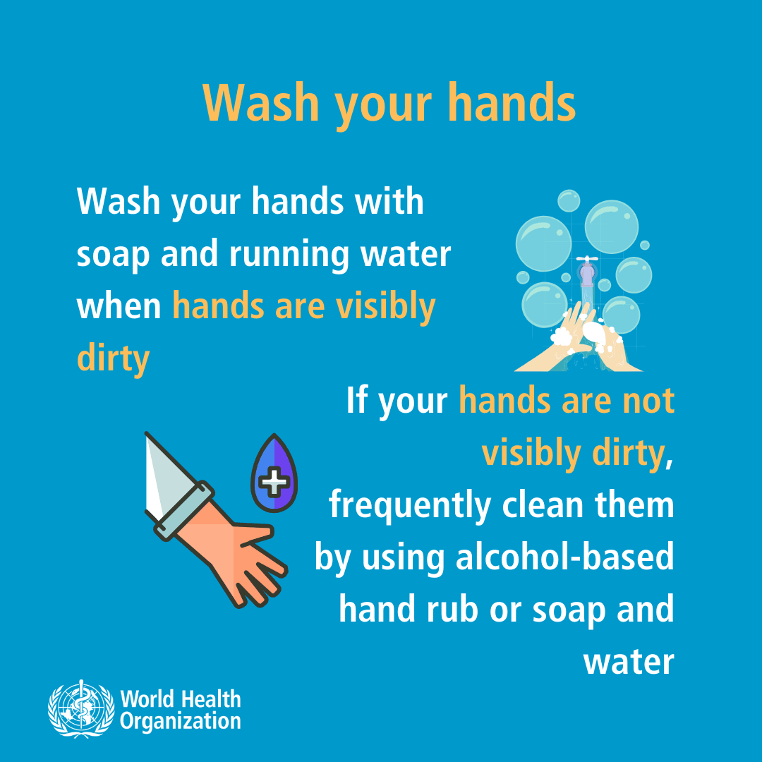




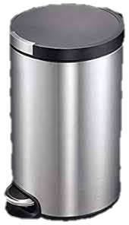

TOSHIBA
ممنوع التدخين
1
No smoking
3
5
4
2
G
GOOD bye!

