Slide 1

Hello everyone.. Today our lecture is talking about the present simple also we will study about present continuous and present simple & how to use present tens for future

Slide 2




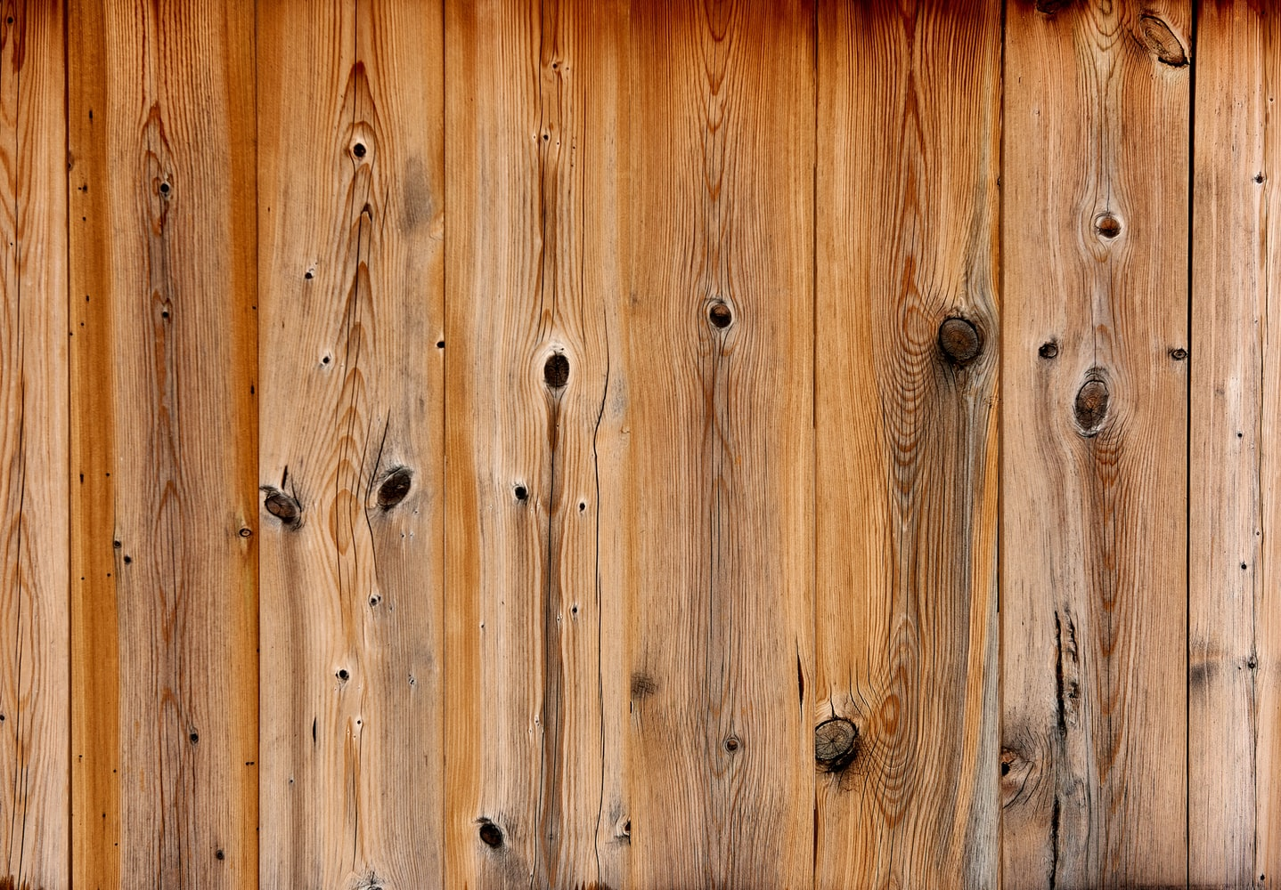
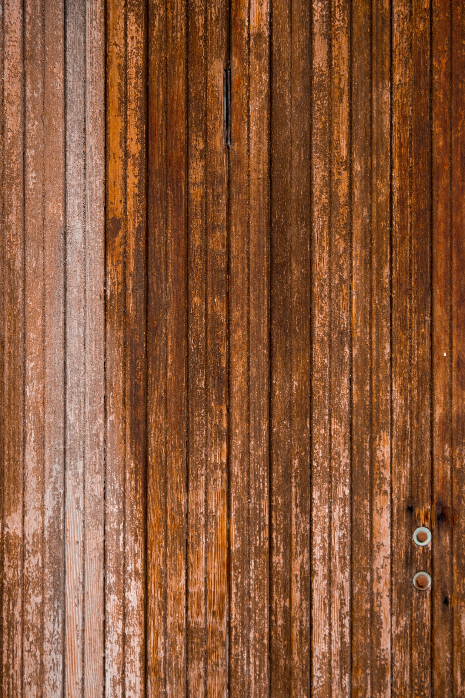
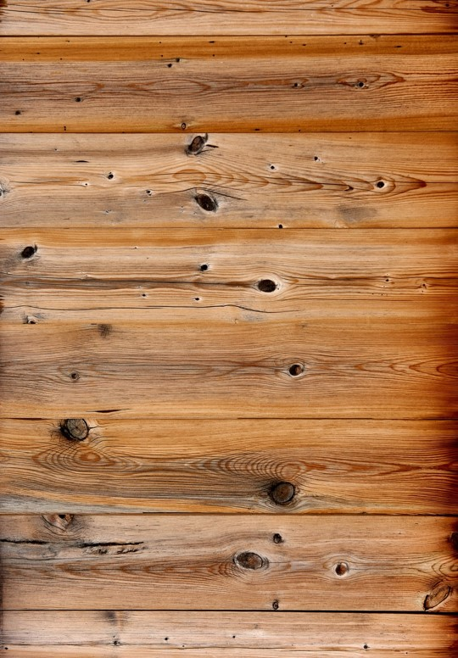
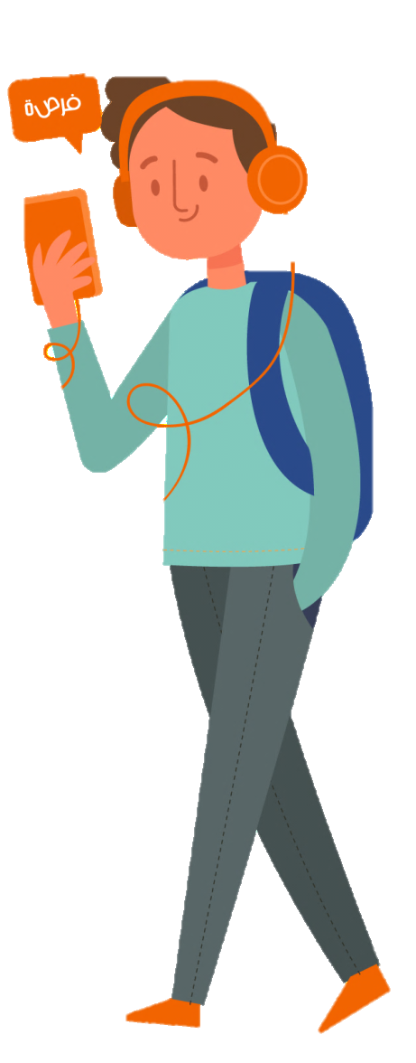
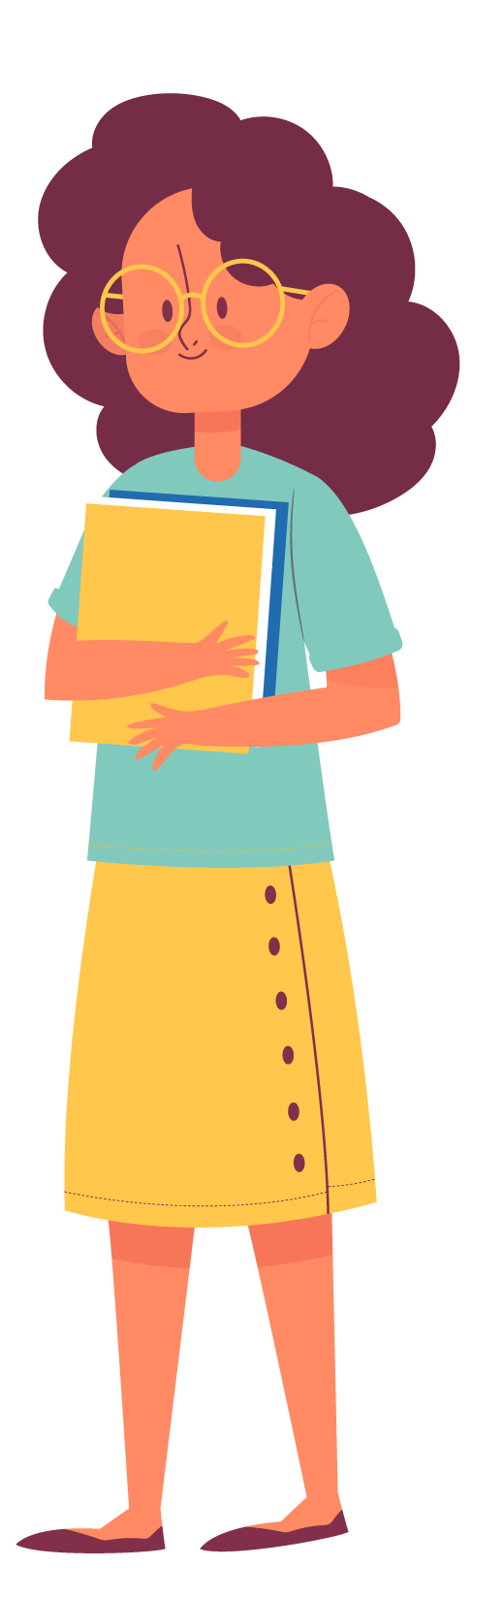

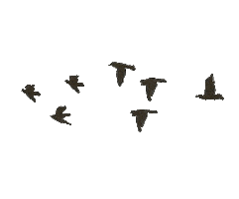
Welcome

Slide 3

I will take you in five sections of my lecture….
1
2
3
4
5

Slide 4
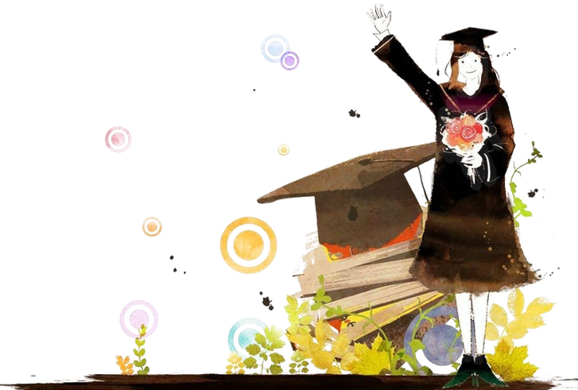
Our lecture is talking about
The structure of this tense
Our lecture is talking about
When can we use this tense
How to make question sentence
How to make negation sentence
Answer all the questions

Slide 5
Tenses in English

Slide 6
Verbs in English
Main verbs
Auxiliary verbs
Verbs in English

Slide 7

Forms of verb in sentence
Gone, written, played
Past Participle
Going, writing, playing
Present Participle
went, wrote, played
Past verb
goes, writes, plays
3 person singular
go, write, play
Base of verb

Slide 8

Auxiliary verbs
Primary Auxiliary
Verb to be
Verb to do
Verb to have
Modal Auxiliary
Shall, should – can, could – will, would
Smi Modal Auxiliary
Used to, need, dare

Slide 9
Tenses in English
Present
Simple
Continuous
Perfect
Perfect Continuous
Past
Simple
Continuous
Perfect
Perfect Continuous
Future
Simple
Continuous
Perfect
Perfect Continuous

Slide 10
interrogative
Negative
Affirmative
usage

Slide 11
Present Simple

Slide 12
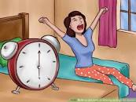
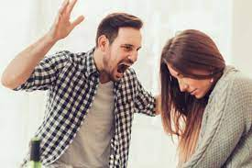
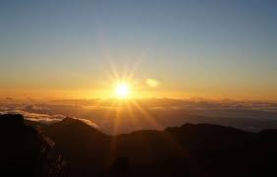
Repeated action
In general
Fatima always gets up at six o'clock every morning.
facts
Ali is angry with his wife.
Sun gives us light.
When can we use the present simple

Slide 13
Structure of present simple
Subject + verb + complete
He, she, it + verb ( s ) + complete
Subject + do + not + verb + complete
Subject +does + not + verb ( without s ) + complete
Do + subject + verb + complete?
Does + subject + verb (without s ) + complete

Slide 14
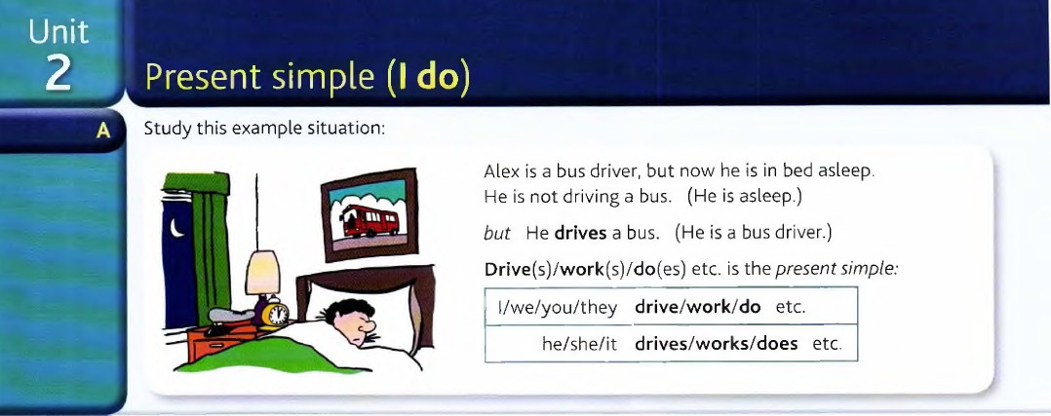

Slide 15
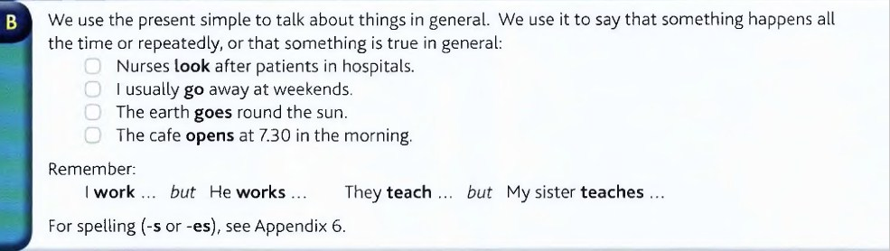

Slide 16
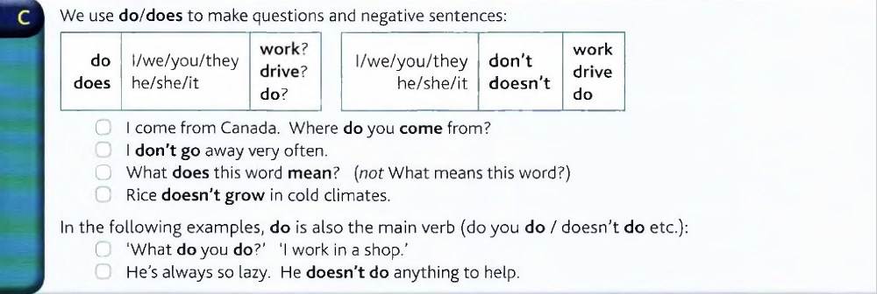

Slide 17
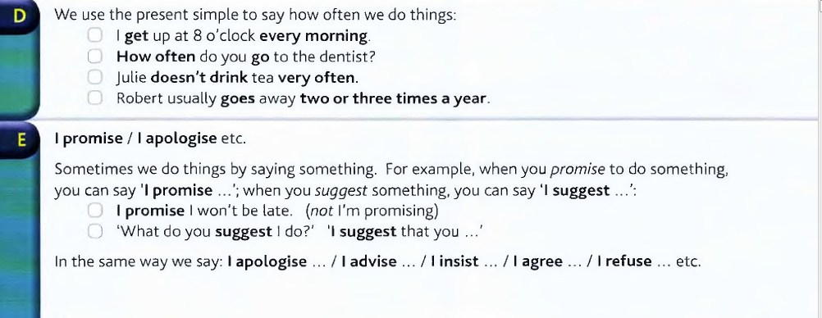

Slide 18

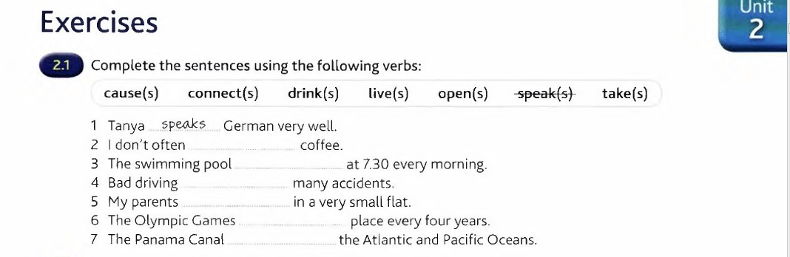
connects
take
live
causes
opens
drink

Slide 19
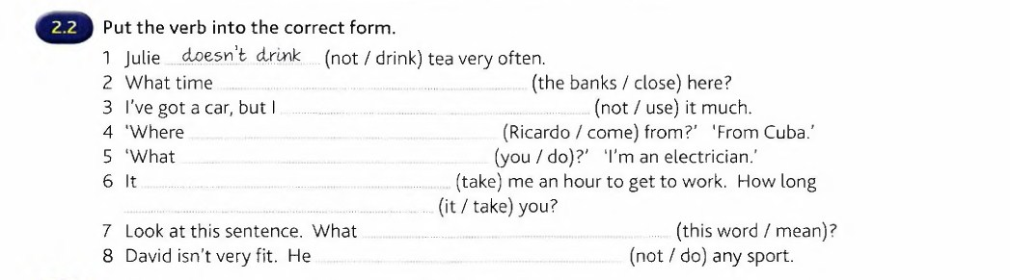
do the banks
do not use
does Ricardo come
do you do
takes
does it take
does this word mean
does not do

Slide 20
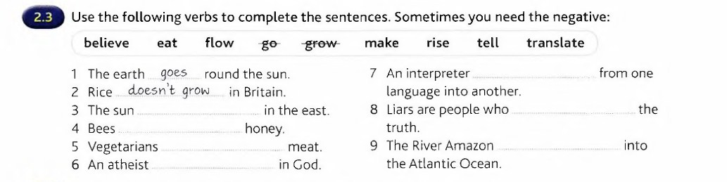
translates
rises
do not tell
make
do not eat
flows
does not believe

Slide 21
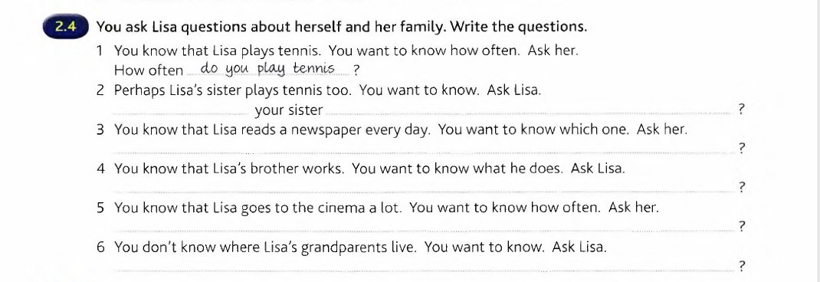
Does
play tennis
Which newspaper do you read
What does your brother do
How often do you go to the cinema
Where do your grandparents live

Slide 22
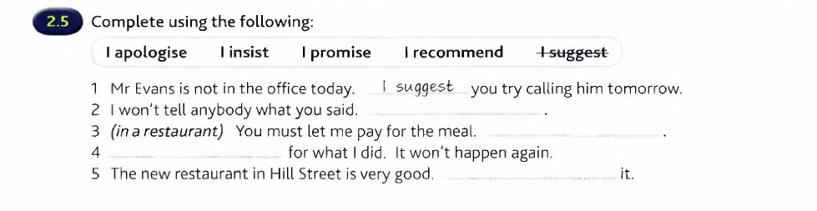
I promise
I insist
I apologise
I recommend

Slide 23
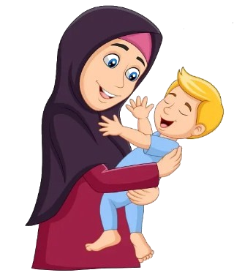

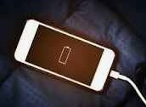
01
02
03
Most of mothers always tickle their babies.
My mobile is out of juice.
You look fishy!!!!
OPEN
OPEN
OPEN

Slide 24
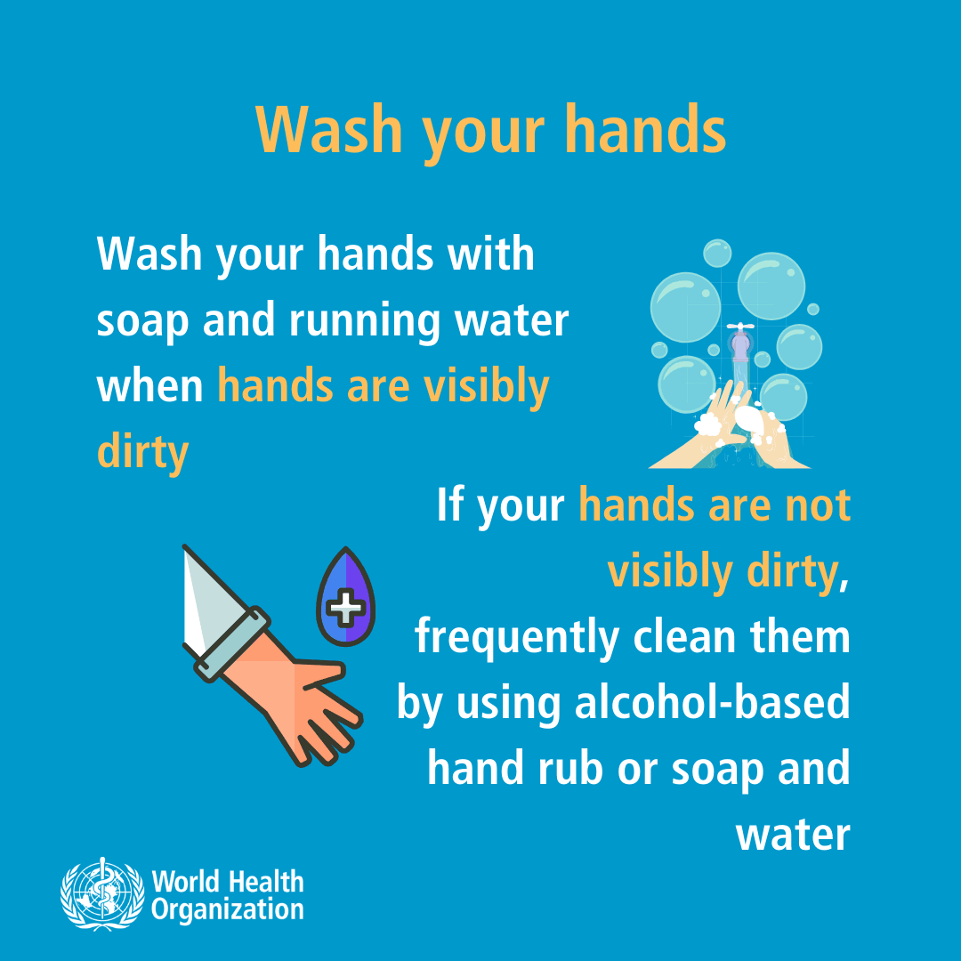



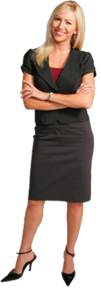
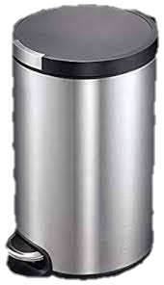

TOSHIBA
ممنوع التدخين
1
No smoking
3
5
4
2
G

